Slide 1
Loops. Error Handling, Strict mode
by Rostyslav Synenko

Slide 2
Loops in JavaScript Looping in programming languages is a feature which facilitates the execution of a set of instructions/functions repeatedly while some condition evaluates to true. For example, suppose we want to print “Hello World” 10 times. This can be done in two ways as shown below:

Slide 3
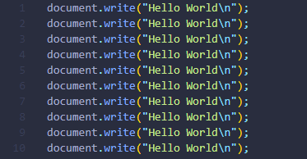
Iterative Method

Slide 4

Using Loops In Loop, the statement needs to be written only once and the loop will be executed 10 times as shown below:

Slide 5
Two Types of loops 1. Entry Controlled loops: 2. Exit Controlled loops:
Notes:
Entry Controlled loops: In this type of loops the test condition is tested before entering the loop body. For Loop and While Loop are entry controlled loops.
Exit Controlled Loops: In this type of loops the test condition is tested or evaluated at the end of loop body. Therefore, the loop body will execute at least once, irrespective of whether the test condition is true or false. do – while loop is exit controlled loop.

Slide 6
Different Kinds of Loops JavaScript supports different kinds of loops: while - loops through a block of code while a specified condition is true do/while - also loops through a block of code while a specified condition is true for - loops through a block of code a number of times for/in - loops through the properties of an object for/of - loops through the values of an iterable object as arrays, strings, etc.

Slide 7

while loop This is the simplest looping statement provided by JavaScript. The while loop loops through a block of code as long as the specified condition evaluates to true. As soon as the condition fails, the loop is stopped. The generic syntax of the while loop is:

Slide 8
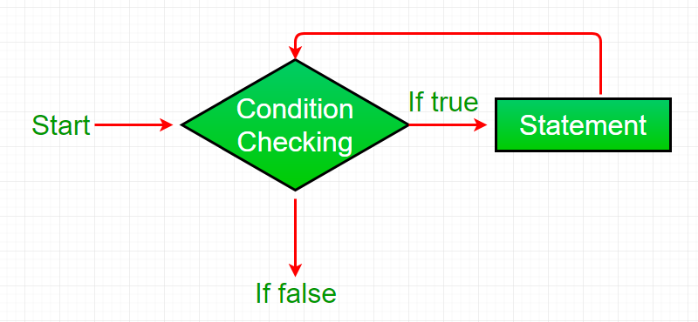
Flowchart:
Notes:
While loop starts with the checking of condition. If it evaluated to true, then the loop body statements are executed otherwise first statement following the loop is executed. For this reason it is also called Entry control loop
Once the condition is evaluated to true, the statements in the loop body are executed. Normally the statements contain an update value for the variable being processed for the next iteration.
When the condition becomes false, the loop terminates which marks the end of its life cycle.

Slide 9
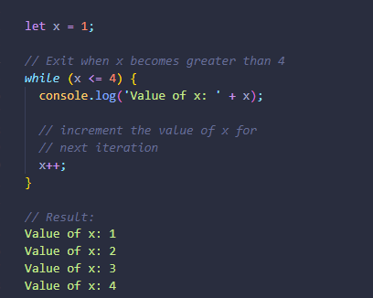
,

Slide 10

do while loop
Notes:
do while loop is similar to while loop with only difference that it checks for condition after executing the statements
The while loop differs from the do-while loop in one important way — with a while loop, the condition to be evaluated is tested at the beginning of each loop iteration, so if the conditional expression evaluates to false, the loop will never be executed.
With a do-while loop, on the other hand, the loop will always be executed once even if the conditional expression evaluates to false, because unlike the while loop, the condition is evaluated at the end of the loop iteration rather than the beginning.

Slide 11
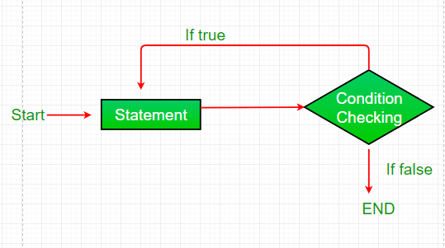
Flowchart:
Notes:
do while loop starts with the execution of the statement(s). There is no checking of any condition for the first time.
After the execution of the statements, and update of the variable value, the condition is checked for true or false value. If it is evaluated to true, next iteration of loop starts.
When the condition becomes false, the loop terminates which marks the end of its life cycle.
It is important to note that the do-while loop will execute its statements atleast once before any condition is checked, and therefore is an example of exit control loop.

Slide 12
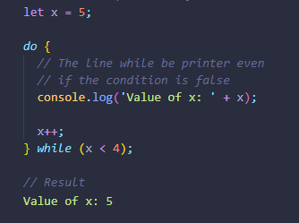
.

Slide 13

for loop The most frequently used loop in JavaScript is the for-loop. The for loop has the following syntax:
Notes:
A for statement consumes the initialization, condition and increment/decrement in one line thereby providing a shorter, easy to debug structure of looping.
for loop provides a concise way of writing the loop structure. Unlike a while loop, a for statement consumes the initialization, condition and increment/decrement in one line thereby providing a shorter, easy to debug structure of looping.

Slide 14
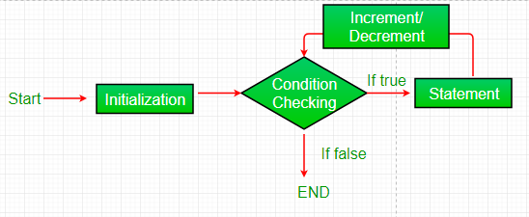
Flowchart:
Notes:
Initialization condition: Here, we initialize the variable in use. It marks the start of a for loop. An already declared variable can be used or a variable can be declared, local to loop only.
Testing Condition: It is used for testing the exit condition for a loop. It must return a boolean value. It is also an Entry Control Loop as the condition is checked prior to the execution of the loop statements.
Statement execution: Once the condition is evaluated to true, the statements in the loop body are executed.
Increment/ Decrement: It is used for updating the variable for next iteration.
Loop termination: When the condition becomes false, the loop terminates marking the end of its life cycle.

Slide 15
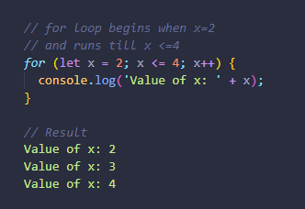
.

Slide 16
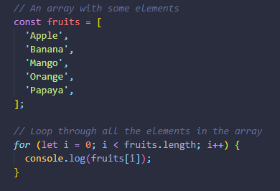
The for loop is particularly useful for iterating over an array.

Slide 17
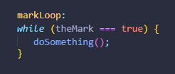
labeled statement A label provides a statement with an identifier that lets you refer to it elsewhere in your program.
Notes:
For example, you can use a label to identify a loop, and then use the break or continue statements to indicate whether a program should interrupt the loop or continue its execution.
The value of label may be any JavaScript identifier that is not a reserved word. The statement that you identify with a label may be any statement.

Slide 18
break statement Use the break statement to terminate a loop, switch, or in conjunction with a labeled statement. - When you use break without a label, it terminates the innermost enclosing while, do-while, for, or switch immediately and transfers control to the following statement. - When you use break with a label, it terminates the specified labeled statement.

Slide 19

The syntax of the break statement looks like this: The first form of the syntax terminates the innermost enclosing loop or switch. The second form of the syntax terminates the specified enclosing labeled statement.

Slide 20
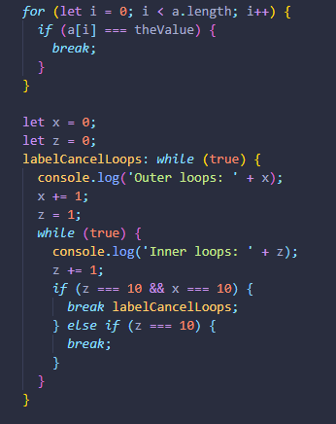
.

Slide 21
continue statement The continue statement can be used to restart a while, do-while, for, or label statement. It skips the rest of the loop and jumps back to the beginning of the loop.
Notes:
When you use continue without a label, it terminates the current iteration of the innermost enclosing while, do-while, or for statement and continues execution of the loop with the next iteration. In contrast to the break statement, continue does not terminate the execution of the loop entirely. In a while loop, it jumps back to the condition. In a for loop, it jumps to the increment-expression. When you use continue with a label, it applies to the looping statement identified with that label.

Slide 22

for…in loop JavaScript also includes another version of for loop also known as the for..in Loops. The for..in loop provides a simpler way to iterate through the properties of an object.
Notes:
In each iteration, one of the properties of Object is assigned to the variable named variableName and this loop continues until all of the properties of the Object are processed.

Slide 23
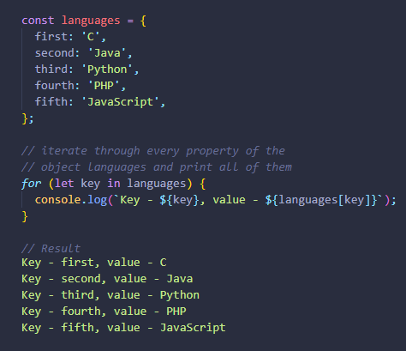
.

Slide 24
for...of loop ES6 introduces a new for-of loop which allows us to iterate over arrays or other iterable objects (e.g. strings) very easily. Also, the code inside the loop is executed for each element of the iterable object. Note: The for...of loop doesn't work with objects because they are not iterable.

Slide 25
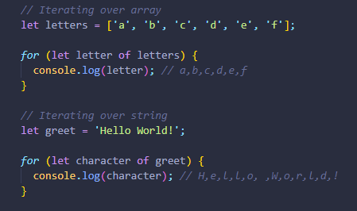
.

Slide 26

Error Handling
Errors
will
happen!

Slide 27
When executing JavaScript code, different errors can occur. Errors can be coding errors made by the programmer, errors due to wrong input, and other unforeseeable things.
Notes:
No matter how great we are at programming, sometimes our scripts have errors. They may occur because of our mistakes, an unexpected user input, an erroneous server response, and for a thousand other reasons.
Usually, a script “dies” (immediately stops) in case of an error, printing it to console.
But there’s a syntax construct try..catch that allows to “catch” errors and, instead of dying, do something more reasonable.

Slide 28
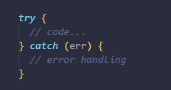
The try…catch syntax The try..catch construct has two main blocks: try, and then catch:
Notes:
The try statement allows you to define a block of code to be tested for errors while it is being executed.
The catch statement allows you to define a block of code to be executed, if an error occurs in the try block.
The JavaScript statements try and catch come in pairs

Slide 29
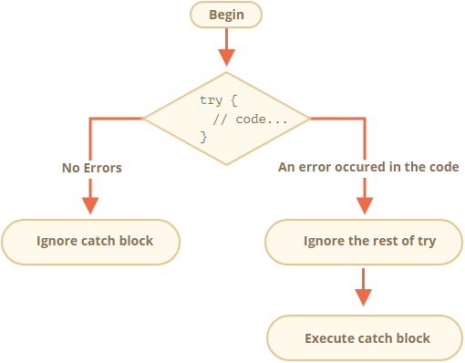
.
Notes:
It works like this:
First, the code in try {...} is executed.
If there were no errors, then catch(err) is ignored: the execution reaches the end of try and goes on, skipping catch.
If an error occurs, then try execution is stopped, and the control flows to the beginning of catch(err). The err variable (can use any name for it) will contain an error object with details about what happened.

Slide 30
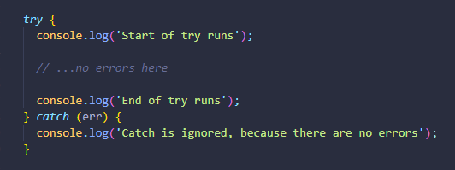
Example

Slide 31
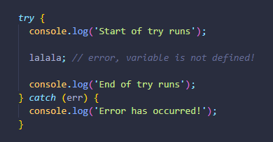
Example

Slide 32
Note: - try..catch only works for runtime errors - try..catch works synchronously
Notes:
For try..catch to work, the code must be runnable. In other words, it should be valid JavaScript. It won’t work if the code is syntactically wrong.
The JavaScript engine first reads the code, and then runs it. The errors that occur on the reading phase are called “parse-time” errors and are unrecoverable (from inside that code). That’s because the engine can’t understand the code.
If an exception happens in “scheduled” code, like in setTimeout, then try..catch won’t catch it: That’s because the function itself is executed later, when the engine has already left the try..catch construct.

Slide 33
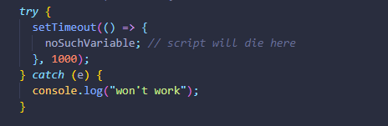
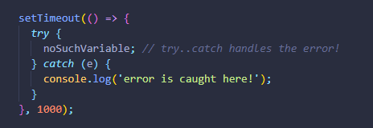
.
Notes:
To catch an exception inside a scheduled function, try..catch must be inside that function

Slide 34
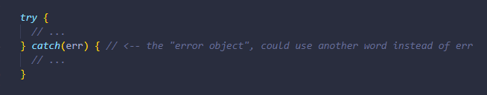
Error object When an error occurs, JavaScript generates an object containing the details about it. The object is then passed as an argument to catch:

Slide 35
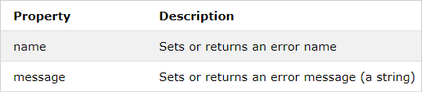
Error Object Properties The error object provides two useful properties: name and message.

Slide 36
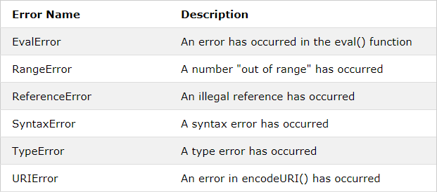
Error Name Values Six different values can be returned by the error name property:
Notes:
An EvalError indicates an error in the eval() function. Newer versions of JavaScript do not throw EvalError. Use SyntaxError instead.
A RangeError is thrown if you use a number that is outside the range of legal values. For example: You cannot set the number of significant digits of a number to 500.
A ReferenceError is thrown if you use (reference) a variable that has not been declared.
A SyntaxError is thrown if you try to evaluate code with a syntax error.
A TypeError is thrown if you use a value that is outside the range of expected types.
A URIError is thrown if you use illegal characters in a URI function.

Slide 37

Throwing our own errors The throw operator generates an error.
Notes:
Technically, we can use anything as an error object. That may be even a primitive, like a number or a string, but it’s better to use objects, preferably with name and message properties (to stay somewhat compatible with built-in errors).
JavaScript has many built-in constructors for standard errors, We can use them to create error objects as well.

Slide 38
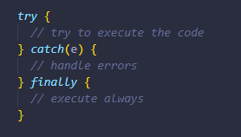
try…catch…finally The try..catch construct may have one more code clause: finally. If it exists, it runs in all cases: - after try, if there were no errors, - after catch, if there were errors.

Slide 39
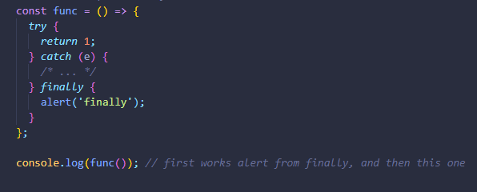
finally and return The finally clause works for any exit from try..catch. That includes an explicit return.

Slide 40
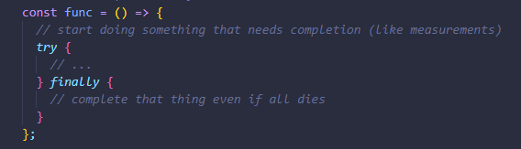
try..finally
Notes:
The try..finally construct, without catch clause, is also useful. We apply it when we don’t want to handle errors here (let them fall through), but want to be sure that processes that we started are finalized.
In the code above, an error inside try always falls out, because there’s no catch. But finally works before the execution flow leaves the function.

Slide 41
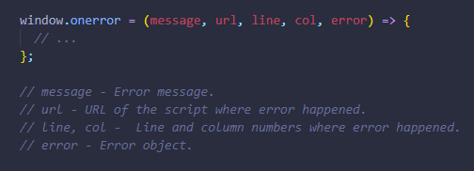
Global catch in the browser we can assign a function to the special window.onerror property, that will run in case of an uncaught error.
Notes:
Let’s imagine we’ve got a fatal error outside of try..catch, and the script died. Like a programming error or some other terrible thing.
Is there a way to react on such occurrences? We may want to log the error, show something to the user (normally they don’t see error messages), etc.
is not a part of the core JavaScript.

Slide 42
Strict mode ECMAScript 5 (ES5) appeared in 2009. It added new features to the language and modified some of the existing ones. To keep the old code working, most such modifications are off by default. You need to explicitly enable them with a special directive: "use strict".
Notes:
Strict Mode is a new feature in ECMAScript 5 that allows you to place a program, or a function, in a “strict” operating context. This strict context prevents certain actions from being taken and throws more exceptions. The statement “use strict”; instructs the browser to use the Strict mode, which is a reduced and safer feature set of JavaScript.

Slide 43
Benifits of using ‘use strict’ - eliminates some JavaScript silent errors by changing them to throw errors. - fixes mistakes that make it difficult for JavaScript engines to perform optimizations: strict mode code can sometimes be made to run faster than identical code that’s not strict mode. - prohibits some syntax likely to be defined in future versions of ECMAScript. - prevents, or throws errors, when relatively “unsafe” actions are taken (such as gaining access to the global object). - disables features that are confusing or poorly thought out. - makes it easier to write “secure” JavaScript.

Slide 44
How to use strict mode Strict mode can be used in two ways – used in global scope for the entire script and can be applied to individual functions. Strict mode doesn’t work with block statements enclosed in {} braces.

Slide 45

Using Strict mode for the entire script To invoke strict mode for an entire script, put the exact statement “use strict”; (or ‘use strict’;) before any other statements.

Slide 46
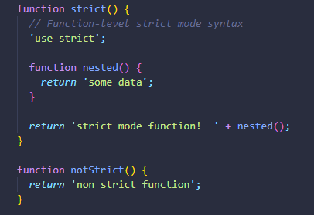
Using Strict mode for a function Put the exact statement “use strict”; (or ‘use strict’;) in the function’s body before any other statements.

Slide 47
Links 1. https://www.geeksforgeeks.org/loops-in-javascript/ 2. https://www.learn-js.org/en/Loops 3. https://developer.mozilla.org/en-US/docs/Web/JavaScript/Guide/Loops_and_iteration 4. https://javascript.info/try-catch 5. https://developer.mozilla.org/uk/docs/Web/JavaScript/Guide/Control_flow_and_error_handling 6. https://developer.mozilla.org/uk/docs/Web/JavaScript/Reference/Strict_mode

